Slide 1
Web Request Life Cycle
Kishore Kumar A N
Kishore.natarajan@aspiresystem.biz
Genesis

Slide 2
Web Request Life Cycle
Every Http request first contacts a DNS server which resolves the request URL domain to a IP address.
After fetching the Webserver IP address request is forwarded to it(via PUT request). A webserver like apache handles this request and forwards this to application which has to handle this.
Genesis

Slide 3
Web Request Life Cycle
In order for a DNS server to resolve a domain to an IP address what first happens is the DNS Resolver (housed on your local device) searches through the browser’s cache. A cache is a block of memory used for temporary data storage that is likely to be used again. If the website was accessed recently by the device the IP address will have been cached — if this is the case the browser will immediately call the IP address to retrieve the web page.
If the IP address is not found in the local cache, the DNS Recursor (which is often the DNS Server of your Internet Service Provider) is accessed and queried. The DNS Recursor has a cache from websites that their clients have recently visited. If the IP address is still not located, the request will be passed to the Domain Server.
Here a request for the record of the domain is sent to the DNS Server and the IP address is returned.
The returned IP address is then used to connect with the host server using the TCP/IP connection and retrieve the webpage via HTTP.
Genesis
Notes:
This slide is only for the trainer… You can display the poll from GTM and after the poll is taken, share the result, connect the poll result with the topic. Once done, you can hide the poll so that the PPT is visible.
I have created the poll in the GTM webinar.

Slide 4
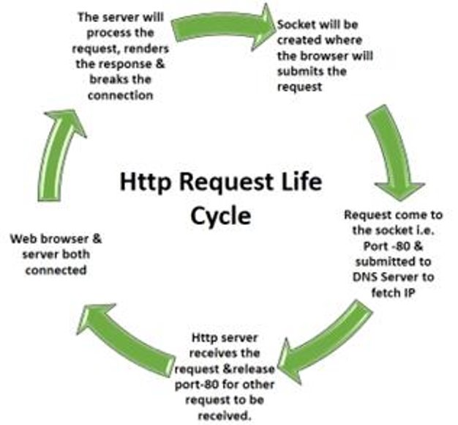
Web Request Life Cycle
Genesis

Slide 5

Genesis

